Slide 1




Hawaii Transformation Initiative
December 2023
DCP : 30-DAY PLACEMENT PLAN

Slide 2

Content
01
Waiver Standard
02
What is a 30-Day Placement Plan?
03
30-Day Placement Plan Elements

Slide 3


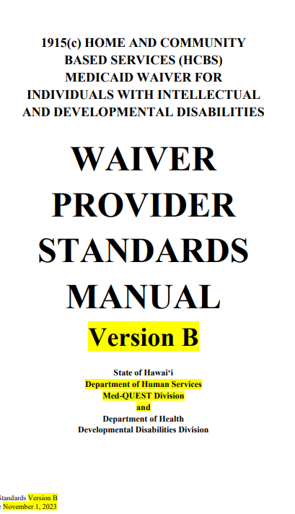

Service Manual
“Discovery & Career Planning (DCP) combines elements of traditional prevocational services with career planning in order to provide supports that the participant may use to develop skills and interests toward becoming employed for the first time or at different stages of the participant’s work career to develop skills and interests for advancement or a change in the participant’s career plan.”

Slide 4





30-Day Placement Plan
A 30-Day Placement Plan is a month-long plan geared towards finding a job. It includes tasks to be accomplished that month, due dates for each task, and the names of people who are responsible for completing those tasks. Every 30 days the plan is updated. The job seeker, their employment specialist, and others in their support network (including family, friends, and employment professionals) can all be involved in writing and implementing the plan.
30-Day Placement Plan
Brief

Slide 5
30-Day Placement Plan
  Creates a sense of urgency.
  Keeps key members of the team engaged.
  Allows for short-term accountability.
  Makes space for natural supports to have monthly tasks
  Intended to be reviewed and updated by the support network monthly.
30-Day Placement Plan
Brief

Slide 6
Identify Tasks
List the tasks to be completed.
30-Day Placement Plan
Brief

Slide 7

  Responsibility
Determine and list who will be responsible for each task
Identify Tasks
List the tasks to be completed.
30-Day Placement Plan
Brief

Slide 8

  Due Date
Establish due dates for each task
  Responsibility
Determine and list who will be responsible for each task
Identify Tasks
List the tasks to be completed.
30-Day Placement Plan
Brief

Slide 9

  Make it Official
Sign the plan and take a copy
  Due Date
Establish due dates for each task
  Responsibility
Determine and list who will be responsible for each task
Identify Tasks
List the tasks to be completed.
30-Day Placement Plan
Brief

Slide 10
Review and update monthly
Identify Tasks
List the tasks to be completed.
  Responsibility
Determine and list who will be responsible for each task
  Due Date
Establish due dates for each task
30-Day Placement Plan
Brief
  Make it Official
Sign the plan and take a copy

